Slide 1
Technology and Oligopoly

Slide 2
outline
tech sector issues: data privacy, defence and security, news, elections ..and democracy..?
concentration of power and wealth -oligopolies everywhere?
economics: opportunity, growth and jobs
regulation of the (new) utilities ?

Slide 3
GAFAM
Fake news affecting elections?
…the Pope endorsed Trump…Macedonians for money
…autocomplete bias: Crooked Hillary
Security and take down .. enough?
Media plurality and filter bubbles?
People farming & privacy..

Slide 4
Inspecting the honey

Slide 5
Google

Slide 6
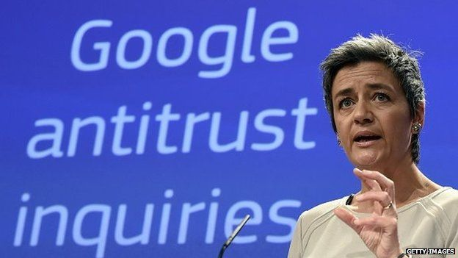
Google investigations
products ( inc shopping, images, news, maps finance etc) in SERPs abuse by self promotion and self preference.
Ad Sense,
Android,
Ad Blocking
Auto Complete

Slide 7
disquiet about mergers?
Alphabet, Amazon, Apple Facebook, Microsoft acquired 463 companies in 10 years for > $100bn – acquisition of innovation?
Google acquires innovation- 200 deals since 2001.
-effects on market structure and innovation: pointing to defects in merger control and control over ‘abuse by acquisition’? 21st Sept 2017 J Laitenberger EU Commission
Generic structural problem?

Slide 8
Increasing concentration

Slide 9
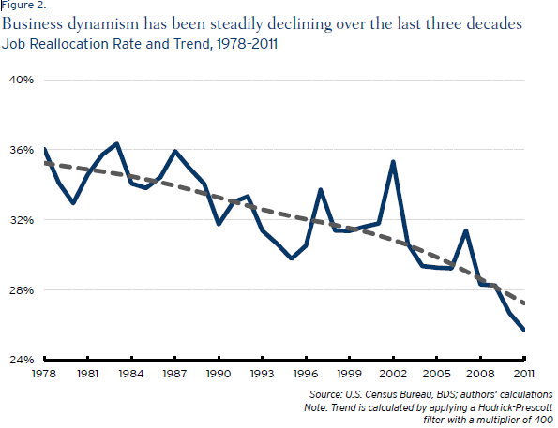

Slide 10
mark ups and dividends

Slide 11
nature and structure matters
Where are we?
“Monopoly competition” driven by advertising?
“Oligopoly”?

Slide 12
Aghion on innovation

Slide 13
How did we get here?

Slide 14
so…where are we?
Oligopolistic or monopolistic competition increasing? higher exit, lower entry, less dynamism, older, higher mark ups and dividends.
Ad funded business can lead to inefficiency.
Innovation rate increases with reduced competition, and reduces with too much (or too little).
Market structure affects growth rates & opportunity.
Consumers have reduced choices
People everywhere faced with the re-feudalisation of society and lack of chance?

Slide 15
the limits of the law?

Slide 16
the ‘database of intentions’
“The Database of Intentions lives in many places, but three or four places in particular hold a massive amount of this data (ie MSN, Google, and Yahoo). This information represents, in aggregate form, a place holder for the intentions of humankind – a massive database of desires, needs, wants, and likes that can be discovered, supoenaed, archived, tracked, and exploited to all sorts of ends. Such a beast has never before existed in the history of culture, but is almost guaranteed to grow exponentially from this day forward. This artefact can tell us extraordinary things about who we are and what we want as a culture. And it has the potential to be abused in equally extraordinary fashion.”
Pamela Jones Harbour ( dissent) FTC Google /Double Click 2007

Slide 17
What do we do?
US context concentration, corporatism and accumulation of power: Democrats propose a “Better Deal” - “Hipster antitrust”
Res Publica: third way?
Public interest merger assessments for (regulated) utility, media plurality, defence and privacy?
Regulation of the new utilities?
Regulation of Oligopoly?

Slide 18
PREISKEL & CO LLP
4 King’s Bench Walk
Temple
London EC4Y 7DL
United Kingdom
Tel: +44 207 332 5640
info@preiskel.com
www.preiskel.com

Slide 19
Awards and Recognition
Global Law Experts ‘Communications Law Firm of the Year 2017’
CorporateINTL ‘Telecommunications Law Firm of the Year 2017’
Chambers & Partners ‘Competition, IT & Telecoms Leading Firm 2017’
Legal 500 ‘Technology, Media and Telecoms Leading Firm 2017’
WhosWhoLegal ‘Telecoms Media & Tech Leading Lawyers 2017’
Best Lawyers ‘Media and Entertainment Law 2017’
Getting the Deal Through ‘National Experts, 2017’

Slide 20
Awards and Recognition

