Slide 1
Addressing climate change through tort law: Implications of Smith v Fonterra
James Every-Palmer KC and Daniel Kalderimis
16 April 2024

Slide 2
1. Introduction

Slide 3
2. Smith v Fonterra in context: Current state of climate change litigation
Level of ambition challenges
Compliance with climate legislation
Requiring public decision-makers to take account of climate issues
Holding emitters directly responsible
Greenwashing claims (to ensure consumer choice is effective)

Slide 4
3. Strike-out: What it is and isn’t; what was decided

Slide 5
4. The role of tikanga
Tikanga is the Māori common law, and is the first law of Aotearoa New Zealand. It consists of templates and frameworks to guide actions and outcomes. The term ‘tika’ means ‘to be right’.
Potential role of tikanga Māori in Smith v Fonterra at trial
Potential influence on development of tort law
Alleged loss includes as kaitiaki of his whenua, wai and moana

Slide 6
5. Perspectives on Smith v Fonterra

Slide 7
Climate change: An intergenerational externality wrapped inside a collective action problem
Greenhouse gas emissions produce a negative externality
The causal chain between emissions and harm is complex:
Multiple sources, normal activities, effects dispersed temporally and geographically, uncertainty, etc
Intergenerational: harms from emissions today will arise for generations to come
Coase theorem: When information and transaction costs are low, the market will produce an efficient solution to the problem of nuisances without regard to where the law places liability. But here transaction costs are extremely high, so a market failure is inevitable.
The geographic and temporal distribution of climate impacts also suggests regulatory failure:
State action imposes costs on today’s voters for the benefit of tomorrow’s voters
States also face a prisoners’ dilemma: Best course globally is for everyone to take appropriate steps, but the rational course for an individual nation may be for faux ambition and shirking

Slide 8
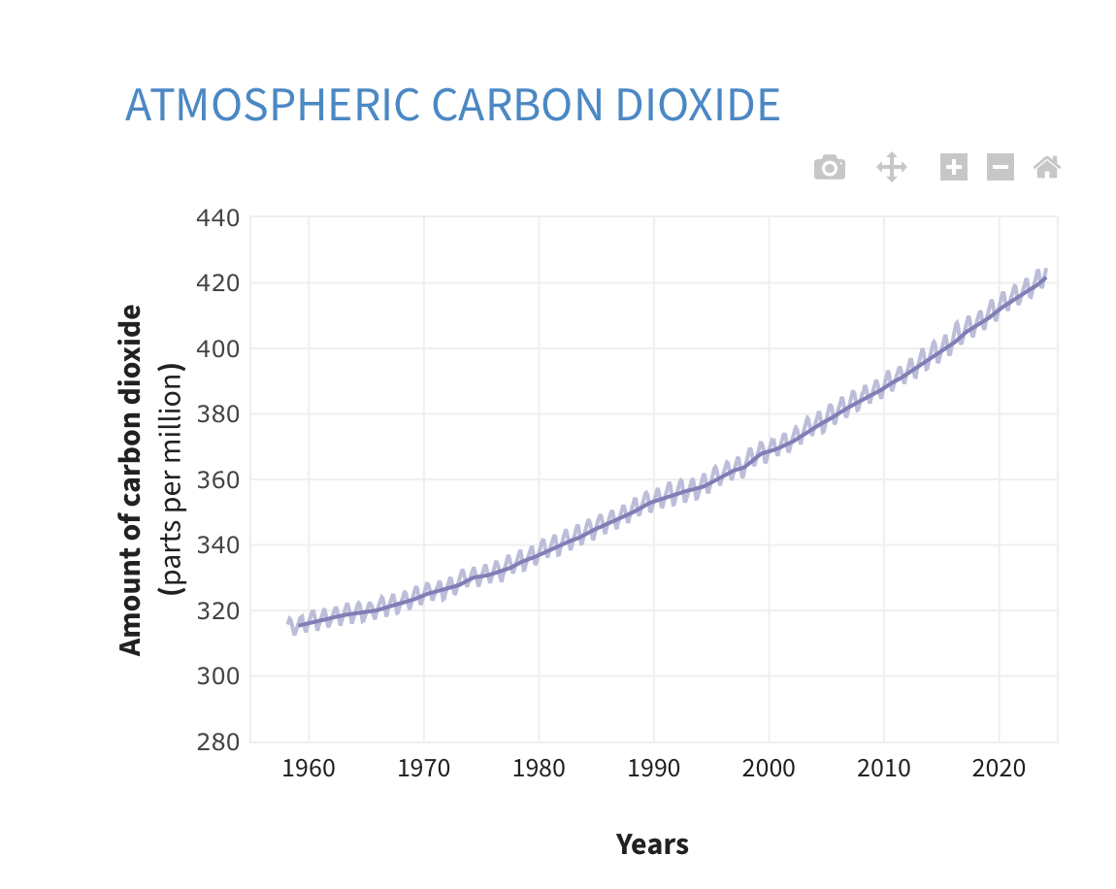
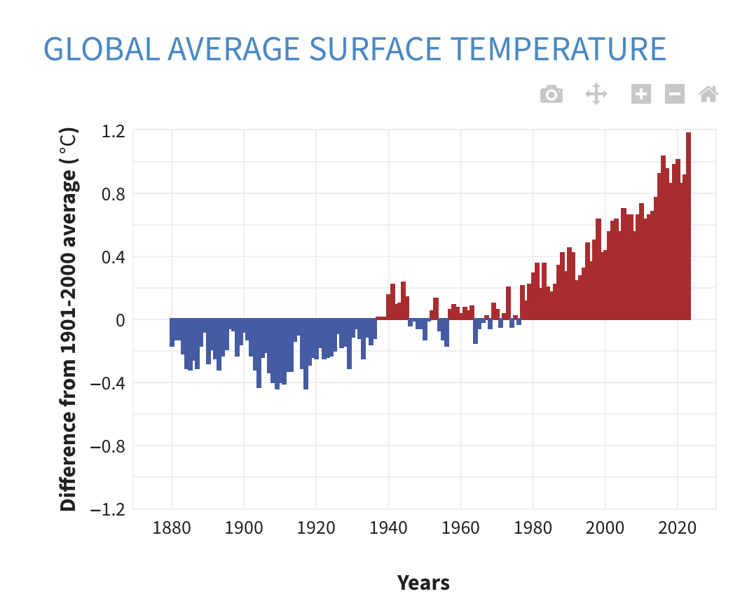
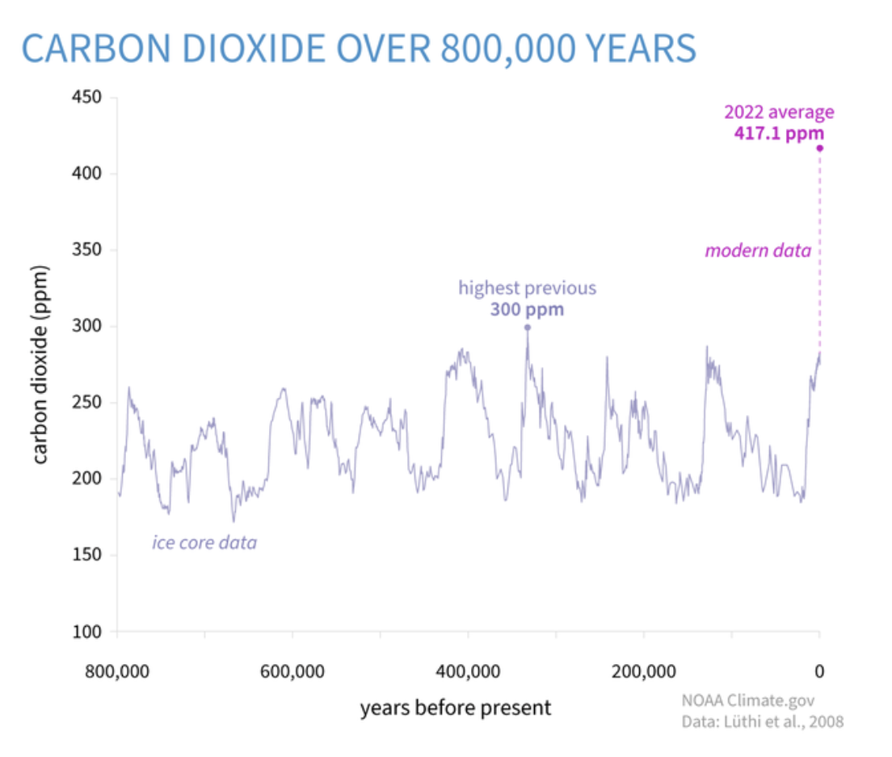
Consistent with this theory, the world is tracking towards a suboptimal outcome (say 3°C warming) with carbon prices at much less than the social cost (~$US200/tonne)

Slide 9
New Zealand’s track record fits with the theory too…

Slide 10
Returning to Smith v Fonterra …
The Court of Appeal said “no role for tort law here”:
“... the magnitude of the crisis which is climate change simply cannot be appropriately or adequately addressed by common law tort claims pursued through the courts. It is quintessentially a matter that calls for a sophisticated regulatory response at a national level supported by international co-ordination.”

Slide 11
An alternative view in the spirit of Coase and given the risk of regulatory failure
Corollary of Coase theorem is that when transaction costs are high, the initial allocation of rights is extremely important (because likely determinative)
In the economic analysis of tort law, the purpose of liability rules is to internalize externalities (eg from pollution)
Courts may have institutional advantages which overcome some of the obstacles to welfare maximising State action on climate change:
Intergenerational thinking (protection against burdens being offloaded into the future)
Mutual advantage for nations overall: Courts overcame a collective action problem in relation to the development of the rules of private international law (conflicts of law)

Slide 12
What might “climate comity” look like?
In private international law, common law courts generated principles of comity in terms of which laws to apply and when to enforce judgments in cross border cases
Rules were developed by courts in different countries for mutual benefit, not narrow self-interest (eg choice of law, enforcement of foreign judgments)
Comity principles could be developed in relation to climate change
Each country has its share of remaining carbon budget for 1.5/2°C and so must make a fair share of reductions (common but differentiated)
Aggregation of global and temporal consequences to domestic emitters

Slide 13
What might an appropriate liability rule look like?
The issue of property rights between current polluters and future generations is novel. That is, the present de facto position (no liability) is not a conscious choice.
Following Coase and the importance of initial allocation, how might a property right in favour of future generations be expressed?
Tort: Imposing liability for “substantial and unreasonable” emissions
Human rights: Recognising the right to a stable environment free from the adverse impacts and vagaries of climate change
The detail of what this means in practice for a particular country could be supplied by the climate comity principles
Result: Judicial guard rails on inadequate State action could address the intergenerational externality and the collective action problem

